Slide 1
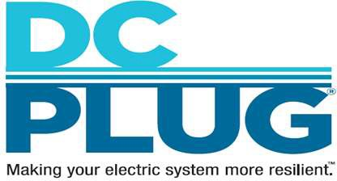
District of Columbia Power Line Undergrounding (DC PLUG) Initiative
Presented to: ANC 5F Presented by: DC PLUG Team
Date: October 24, 2023
www.dcpluginfo.com

Slide 2
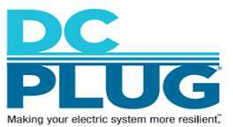
Agenda
Background and History
Feeder Selection Process
Biennial Plan Feeder Locations
DC PLUG Major Milestones
DC Business Engagement
Integrated Communications Strategy – DC PLUG Education Plan
Contact Us
2

Slide 3
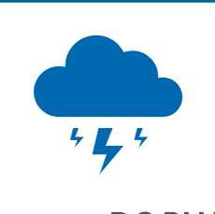
Background
Background & Timeline
Aug 2012
The Mayor’s Power Line Undergrounding Task Force is established
May 2013
The Task Force recommends a partnership between Pepco and the District of Columbia
May 2014
The Electric Company Infrastructure Improvement Financing Act becomes law
May 2017
Council of the District of Columbia amends the law Nov 2017
The Public Service Commission of the District of Columbia approves the First Biennial Plan
Jan 2020
The Public Service Commission of the District of Columbia approves the Second Biennial Plan
Jan 2022
Approval from Public Service Commission of the District of Columbia on the Third Biennial Plan
DC PLUG will provide resiliency against major storms and improve the reliability of the electric system
Budget
Pepco Portion
$250 Million
Recovered through Pepco Underground Project Charge
District Portion
$187.5 Million
Recovered through Underground Rider
DDOT
up to $62.5 Million
DDOT Capital Improvement Funding
Multi–year program to underground up to 20 of the most vulnerable overhead distribution lines, spanning over 6-8 years with work beginning in early 2019

Slide 4
Feeder Selection Process
In selecting the feeders, DDOT and Pepco followed a five-step process:
Based on data from January 1, 2010 through December 31, 2016 for first biennial; January 1, 2010 through December 31, 2018 for second biennial, and
January 1, 2010 through December 31, 2020 for third biennial, ranked feeders by historical reliability and customer minutes of interruptions reduced per dollar spent (SAIFI, SAIDI, CMI/$).
Identified the highest-ranked feeders in each of the five Wards (Wards 3, 4, 5, 7 and 8) of the District of Columbia characterized by a large concentration of overhead power lines and susceptibility to overhead outages.
Analyzed ongoing reliability work as well as current and planned system work.
Identified opportunities to take advantage of existing or planned DDOT roadway reconstruction projects.
Finalized the feeder selection for inclus⁴ion in each Biennial Plan.

Slide 5
Biennial Plan
In accordance with the Act, Pepco and DDOT filed a joint Biennial Plan on July 3, 2017 covering the two-year period, 2017-2019. The Second Biennial Plan was filed on September 30, 2019, and the Third Biennial Plan was submitted to the PSC on September 30, 2021.
Under the Biennial Plan, DDOT primarily will construct the underground facilities, and Pepco primarily will install the underground electric distribution for six overhead feeders affected by outages.
1st Biennial Feeder | Ward | Neighborhoods
308 | 3 | American University Park, Friendship Heights
14900 | 4 | Hawthorne, Barnaby Woods, Chevy Chase, Friendship Heights
15009 | 4 | Takoma Park, Manor Park
14007 | 5 | Brookland, Michigan Park, Woodridge
368 | 7 | Benning Ridge, Fort Dupont Park, Dupont Park, Civic Betterment, Marshall Heights, Fort Davis
14758 | 8 | Congress Heights, Joint Base Anacostia-Bolling, Washington Highlands, Bellevue
* The planned work for Feeder 14900 coincides with DDOT’s Oregon Ave road reconstruction project.

Slide 6
Biennial Plan
2nd Biennial Feeder | Ward | Neighborhoods
467 | 3 | Chevy Chase
14767 | 3 | Kent, Palisades, Fort Drive, Foxhall Crescents, Berkley, Wesley Heights
15001 | 4 | 16th Street Heights, Crestwood, Rock Creek Park
15021 | 4 | Brightwood, Petworth, Chillum
14008 | 5 | Woodridge, Brentwood
14093 | 5 | Brookland, Brentwood, Woodridge, National Arboretum, Gateway, Fort Lincoln
118 | 7 | Twining, Hillcrest, Randle Highlands, Penn Branch, Fort Davis
14702 | 7,8 | Fairlawn, Randle Heights, Randle Highlands, Twining, Good Hope, Skyland
15166 | 8 | Congress Heights, Congress Park, Randall Heights
15171 | 8 | Congress Park, Douglass Dwellings, Shipley, Congress Heights

Slide 7
Biennial Plan
3rd Biennial Feeder | Ward | Neighborhoods
00075 | 3 | American University Park/ Spring Valley
00347 | 7 | Randle Highlands / Hillcrest
14009 | 5 | Edgewood
15174 | 8 | Shipley / Douglass / Buena Vista / Knox Hill

Slide 8
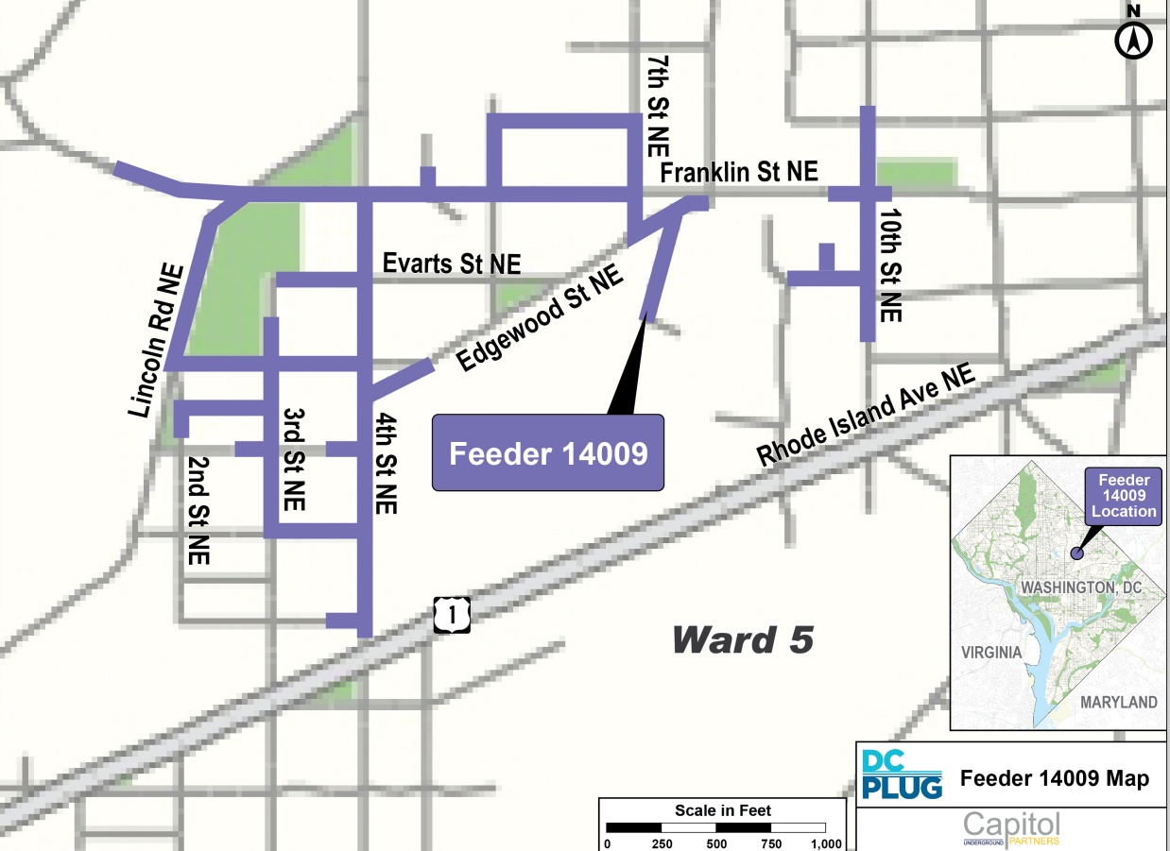
Feeder 14009 Location Map
8

Slide 9
DC Business Engagement
Contractor Forums
Pepco and DDOT jointly hosted contractor forums, sponsored a DC PLUG Initiative Networking Event for contractors, and hosted a project schedule update webinar for contractors
Engagement
Pepco and DDOT will continue to conduct one-on-one meetings with Certified Business Enterprises (CBEs) and attend local events to learn about the capacity and capability of the local contracting community
Communications
Pepco hired a woman-owned CBE firm responsible for development of all DC PLUG communications materials
9

Slide 10
Integrated Communications Strategy – DC PLUG Education Plan
Executing the DC PLUG Education Plan
Project Meeting Playbook
Project Introduction (2 months prior)
Pre-Construction (at start of construction)
Construction Progress (during construction)
Emergency Meetings (if challenges arise)
Common Collateral
Social Media Outreach
Undergrounding video
Project Fact Sheets
Flyers, Door Hangers
Project Area Maps
Work Site Signs
Outbound call(to notify about meeting, 30 days prior)
Project Hot Line: 1-844-758-4146
Project Web Site: dcpluginfo.com
Project Email Address: questions@dcpluginfo.com
10

Slide 11
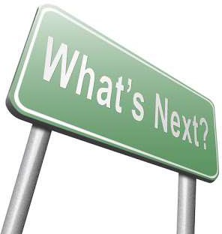
Next Steps – With Focus on Feeder 14009
Attendance at appropriate ANC and Civic Association meetings
Virtual Open House (Expected Around March 2024)
Communication to Stakeholders
Placement of door hangers
Worksite signs

Slide 12
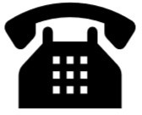
www.dcpluginfo.com
Contact Us
questions@dcpluginfo.com
Questions?
1-844-758-4146
@pepcoconnect #DCPLUG

