Slide 1
DC PLUG Initiative – Open House
Feeder 467
July 17, 2024
District Department of Transportation (DDOT) and Pepco
Civil Design

Slide 2
Welcome to our virtual public meeting!
To begin, we will review some basic controls to help you participate virtually on this platform.
Please Note: This is an open meeting and as required by DC Code 2-578, this meeting is being recorded, and the recording will be made available to the public.
The video file (with both audio and video) will be shared on DDOT’s YouTube Channel (YouTube.com/DDOTVideos) within 7 days after the meeting has ended.
This meeting is being live streamed to DDOT’s Facebook page: Facebook.com/DDOTDC
If you do not wish to have your voice recorded, please do not ask to speak. You may enter any questions or comments in the Q&A which we will review in the next few slides.
If you need technical support during this meeting, please call 202-997-8354
Notes:
Enora

Slide 3
Using Webex - Audio & Video
Audio/Muting
Everyone is on mute. You cannot unmute yourself. We can unmute you during the Q&A and Comment period. This helps ensure the meeting runs smoothly and there are no auditory disruptions during the presentation.
To request to speak, you will need to use the Raise Hand feature, which we will cover shortly.
Notes:
Enora

Slide 4
Using Webex – Audio & Video
Audio/Muting
Everyone is on mute. You cannot unmute yourself. We can unmute you during the Q&A and Comment period. This helps ensure the meeting runs smoothly and there are no auditory disruptions during the presentation.
To request to speak, you will need to use the Raise Hand feature.
Closed Captions
Webex has automatic system-generated Closed Captions available during the meeting. Click the CC icon in the lower left corner of the window to turn on Closed Captions. There are additional settings so you may adjust the appearance of the captions if needed.
Using the Webex Mobile Application? Click the 3 dot (…) icon, scroll down and select the Closed Captions option. Make sure the toggle switch is blue.
Video
Your video camera is off by default, and you will not be able to share video.
Notes:
Enora

Slide 5
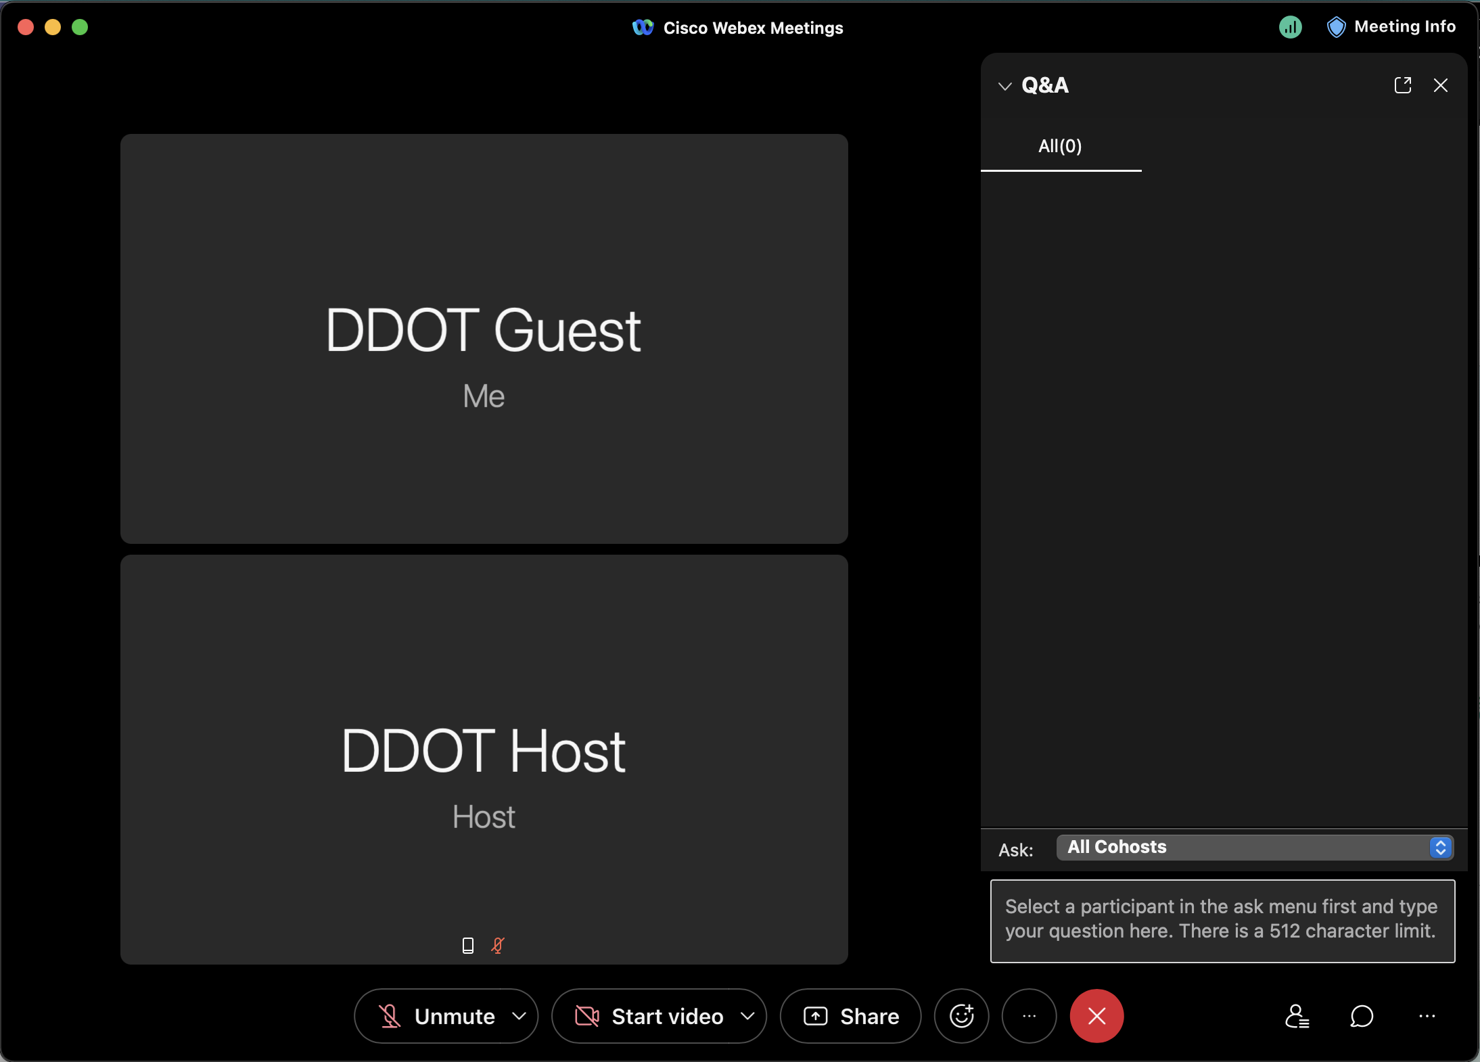
Using Webex - Q&A
If you have a question during the presentation, send it via the Q&A feature.
To Send a Question:
Click the “three dot icon (…)” in the bottom right side of the Webex window and select Q&A.
A new panel or window will appear. In the ”Ask” field, select All Panelists.
Click the text box to type your question and press the Enter key to send it.
If you joined via Browser or Mobile App, click the Q&A or Question Mark icon to access the Q&A to ask a question.
If you dialed in by phone, dial *3 to use the Raise Hand function. This indicates to the Project Team that you would like to speak and ask a question.
Notes:
Enora

Slide 6
Using Webex – Raise Your Hand
​If you have a question or comment that you would like to speak up about, please raise your hand. This indicates to the Project Team that you would like to speak.
To virtually raise your hand:
Click the Participants icon on the bottom right of the Webex window.
Hover your cursor next to your name and click the Raise hand icon
Alternatively, you may press the following keys on your keyboard: Ctrl + Shift + R
If you joined via browser or mobile app, click the 3 dot (…) icon and select Raise Hand.
If you dialed in by phone, dial *3 to use the Raise Hand function.
Notes:
Enora – suggest introduce Robyn for welcome slide

Slide 7
DC PLUG Initiative – Open House
Feeder 467
July 17, 2024
District Department of Transportation (DDOT) and Pepco
Civil Design

Slide 8
Agenda
DC PLUG Introductory Video
DC PLUG Background
Existing System Model
Proposed Underground System Model
Project Status and Timelines
Project Scope and Limits
Maintenance of Traffic
Communications Strategy
Contact Information

Slide 9
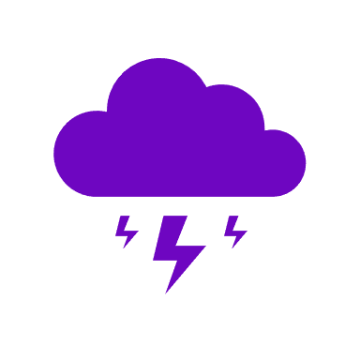
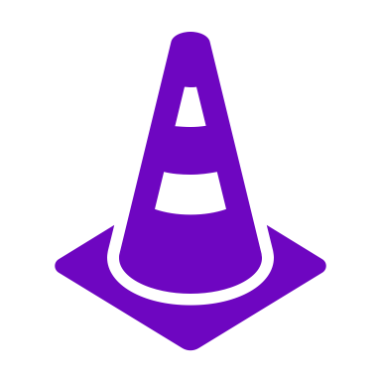
DC PLUG Background
Background & Timeline
Budget
Aug 2012
The Mayor’s Power Line Undergrounding Task Force establishment
May 2013
The Task Force recommended a partnership between Pepco and the District of Columbia
May 2014
The Electric Company Infrastructure Improvement Financing Act became law
May 2017
Council of the District of Columbia amended the law
Nov 2017
Approval from Public Service Commission of the District of Columbia on the First Biennial Plan
Jan 2020
Approval from Public Service Commission of the District of Columbia on the Second Biennial Plan
Jan 2022
Approval from Public Service Commission of the District of Columbia on the Third Biennial Plan
Pepco Portion
$250 Million
Recovered through Pepco Underground Project Charge
District Portion
$187.5 Million
Recovered through Underground Rider
DDOT
up to $62.5 Million
DDOT Capital Improvement Funding
DC PLUG will provide resiliency against major storms and improve the reliability of the electric system
Multi–year program to underground up to 30 of the most vulnerable overhead distribution lines, spanning over 6-8 years with work beginning in early 2019

Slide 10
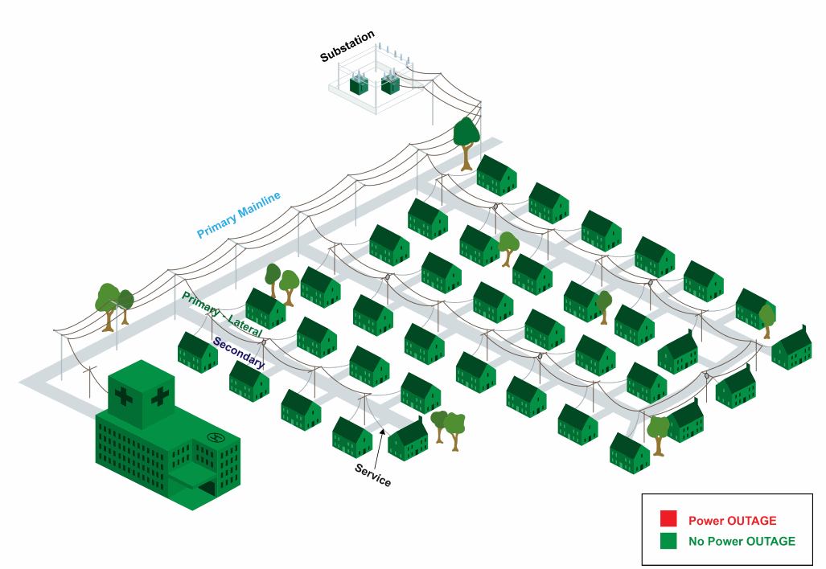
Existing Overhead System (Before DC PLUG)

Slide 11
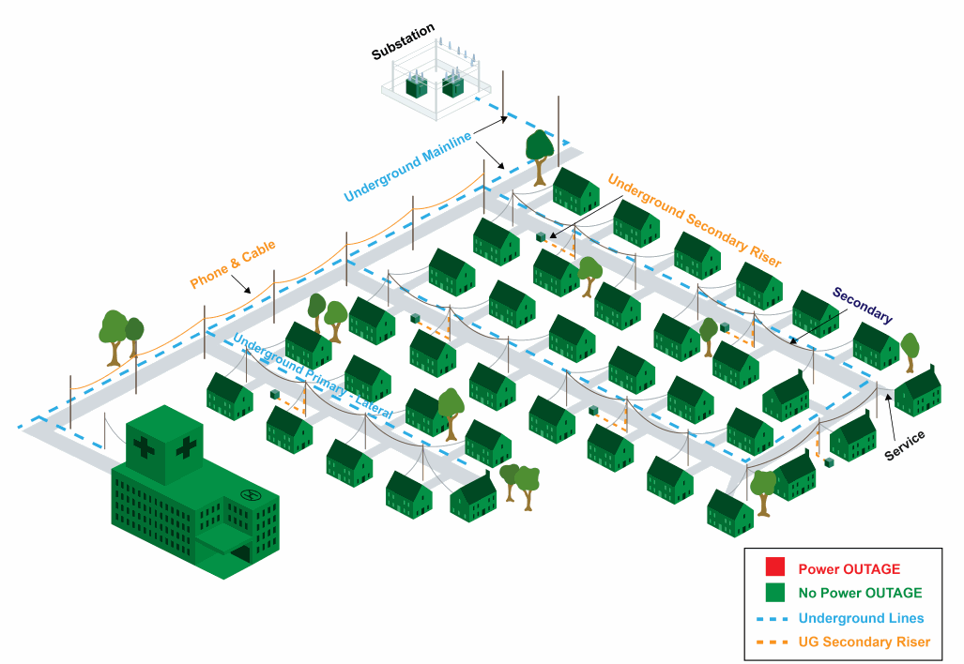
Proposed Underground Plan (After DC PLUG)

Slide 12
Current Status and Timeline – Feeder 467 Design
Project Kick-off March 2023
30% Design Submission September 2023
Meet with Councilmember October 2023
ANC Meetings February 2024
65% Design Submission March 2024
Open-House Public Meeting July 17, 2024
100% Final Submission August 2024
Final Submission Fall 2024

Slide 13
Feeder 467 Construction Timeline*
Civil construction starts
Civil construction completes
Electrical construction completion
Anticipated to be energized
Summer 2025
Summer 2026
Summer 2026
Winter 2027
*Subject to change

Slide 14
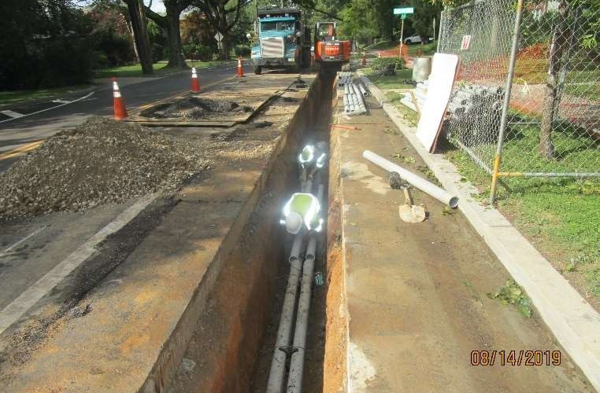
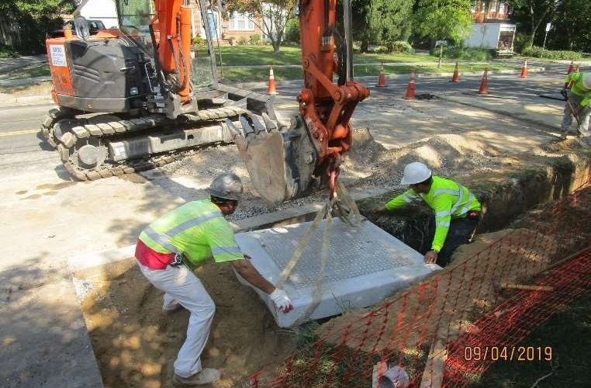
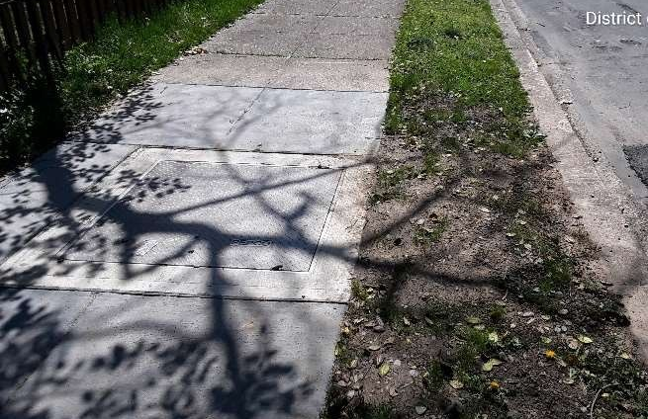
Project Scope
Erosion and sediment control
Installation of duct bank, electrical manholes, tap holes, and transformer enclosures
Roadway restoration
Pavement marking restoration
Electrical work will begin following the completion of the Civil construction

Slide 15
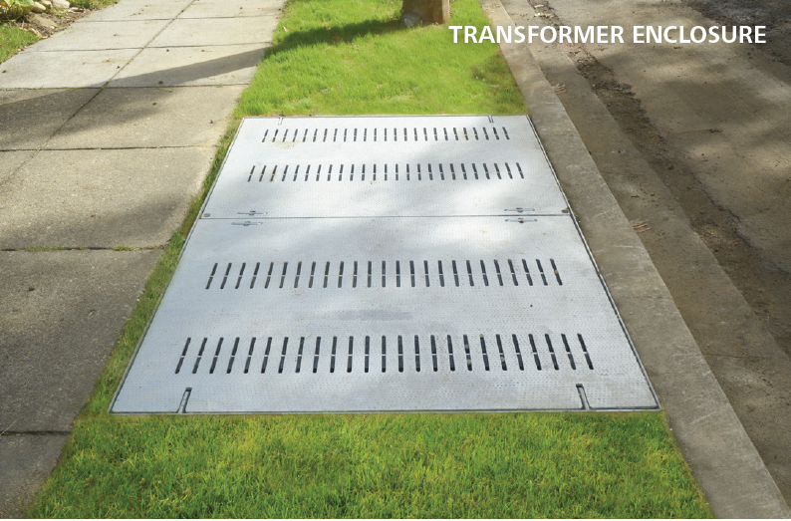
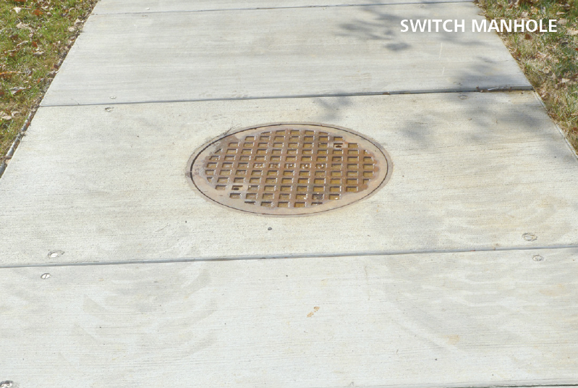
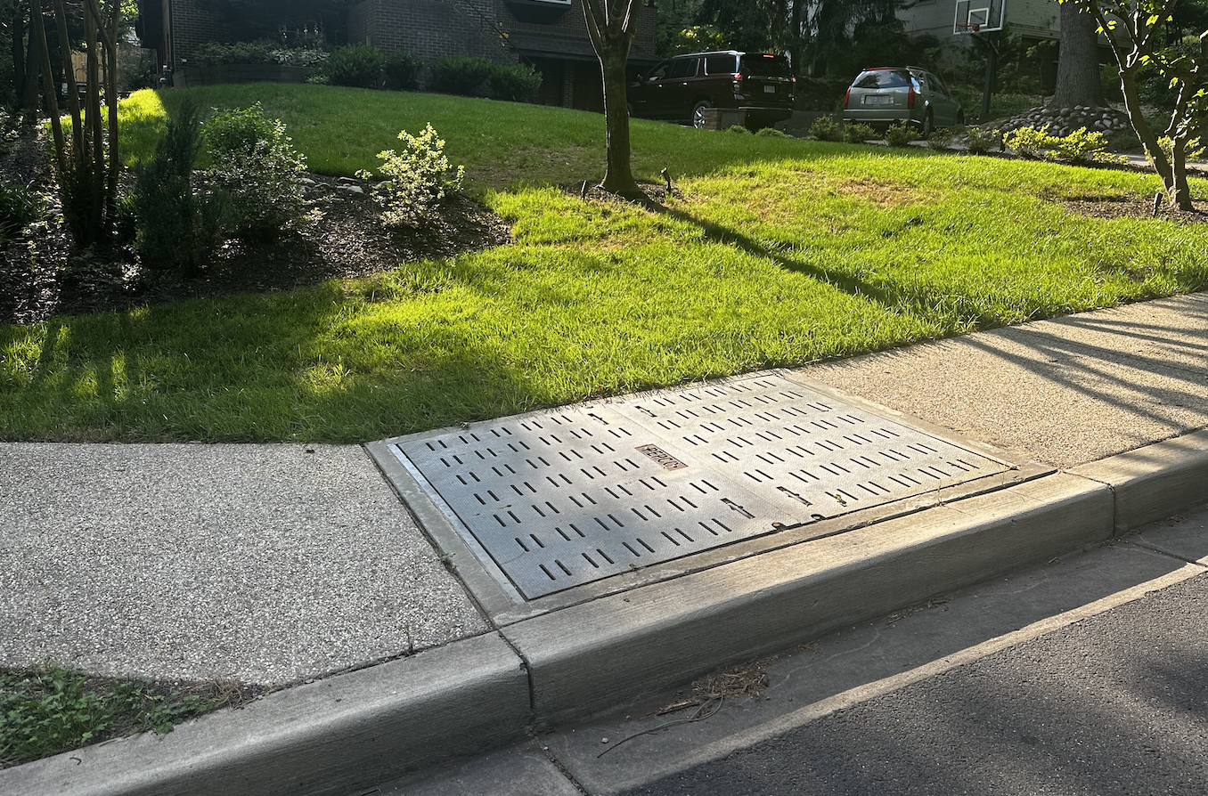
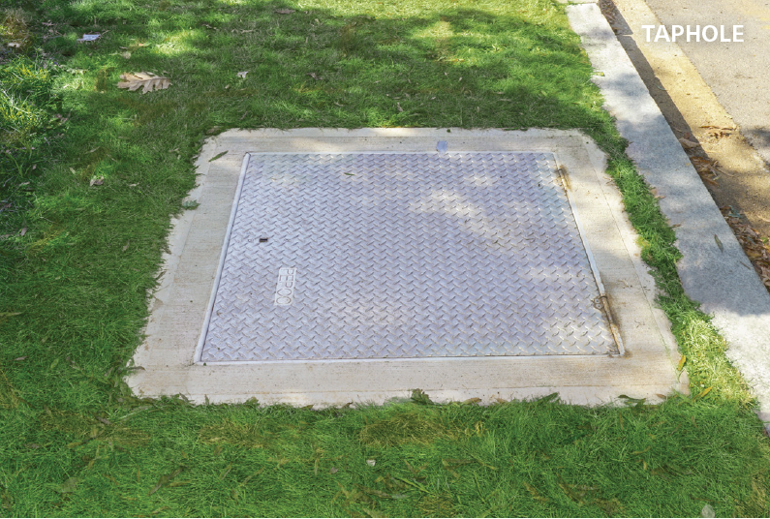
Project Scope
TRANSFORMER ENCLOSURE

Slide 16
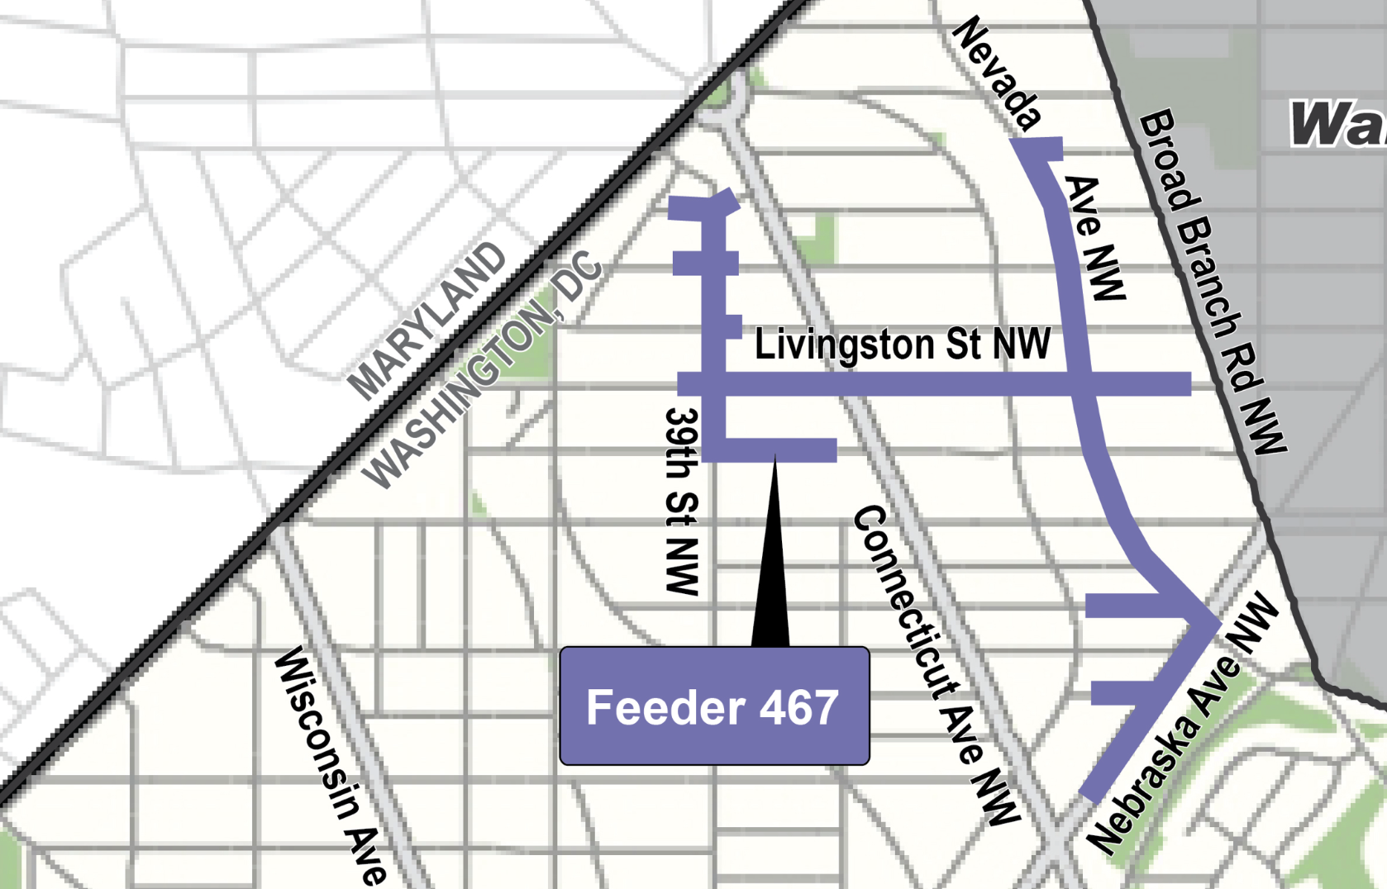
Feeder 467 Map

Slide 17
Maintenance of Traffic During Construction
Maintain accessibility for residents and businesses
Parking Impacts: Minimum 72 hours advance notice
Safe accommodation for pedestrians and bicyclists will be provided during construction
Public outreach team will coordinate with the residents and other stakeholders throughout the construction

Slide 18
Typical Maintenance of Traffic During Construction

Slide 19
Typical Maintenance of Traffic During Construction

Slide 20
Typical Maintenance of Traffic During Construction

Slide 21
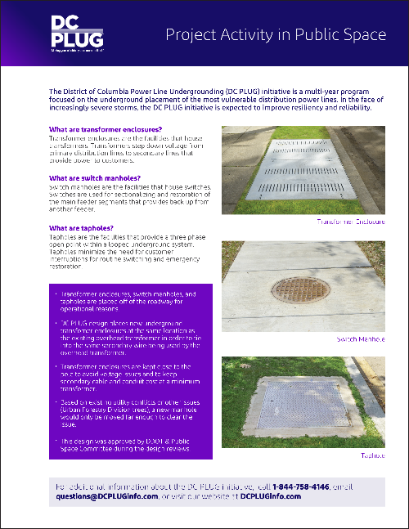
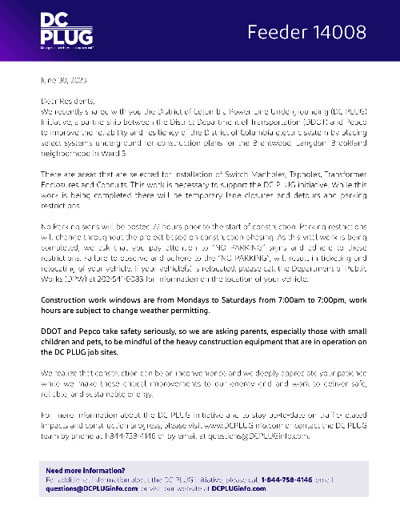
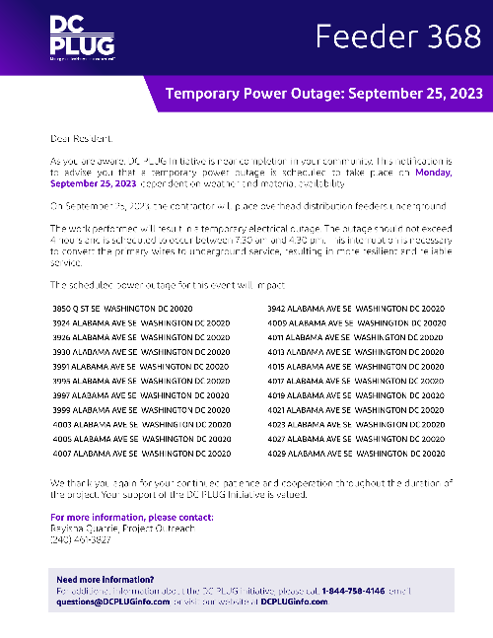
Education Plan Summary
Notes:
Rayisha leads

Slide 22
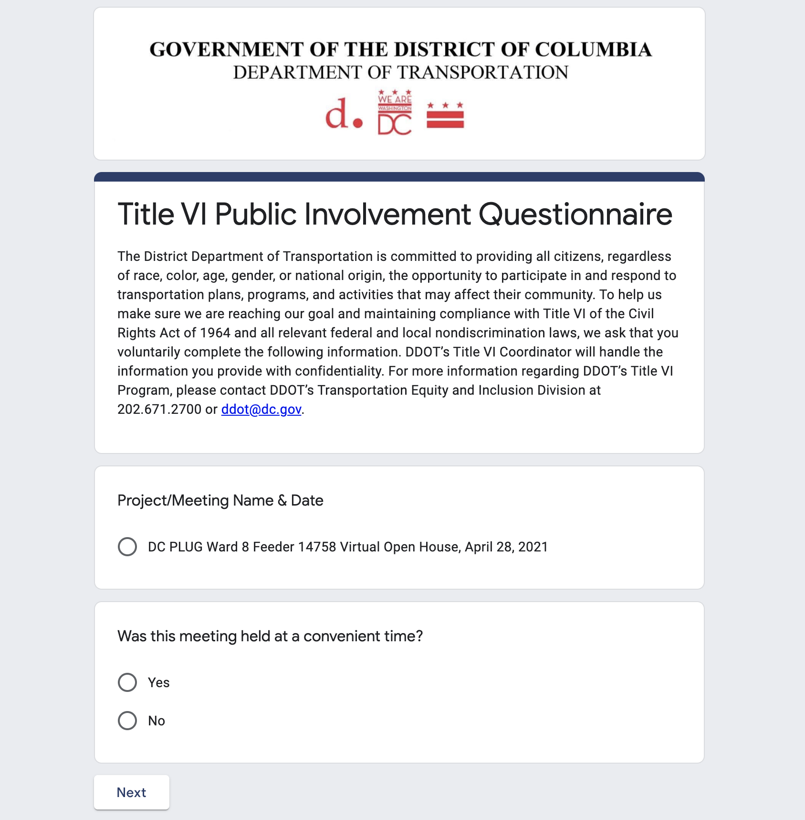
DDOT Title VI – http://tinyurl.com/TitleVI-Survey
As a recipient of Federal assistance, DDOT must ensure that all of its programs, activities and public meetings are conducted in compliance with Title VI of the Civil Rights Act of 1964. This Act ensures nondiscrimination based on race, color or national origin. The Title VI Public Meeting Participant Questionnaire is used
to help DDOT ensure that we are informing the public and conducting our meetings in a nondiscriminatory manner, in compliance with Title VI.
Project comments and/or concerns may also be submitted through this form. We appreciate anyone who is willing to complete the form.
Thank you for your participation.

Slide 23
Contact Us
www.dcpluginfo.com
Questions?
questions@dcpluginfo.com
1-844-758-4146
@pepcoconnect #DCPLUG
@ddotdc #DCPLUG
23

Slide 24
Thank you

